Slide 1


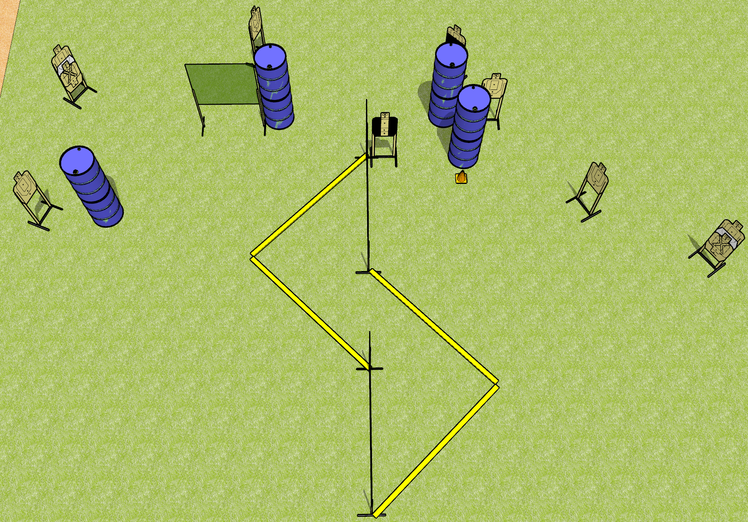
 | Dothan Gun Club – USPSA Match Ssssssssss Course Designer : Drew Coleman
START POSITION : Anywhere outside the shooting area, wrists below belt
GUN READY CONDITION : Pistol loaded and holstered. PCC loaded, held with both hands, shouldered, safety on, pointed at orange cone. |  | SCORING: Comstock, 20 rounds TARGETS: 10 paper, 0 Steel SCORED HITS: Best 2 on paper, steel until down START-STOP: Audible, last shot RULES:
STAGE PROCEDURE: Engage targets as they become available from within the fault lines.

Slide 2
Ssssssssss
Written Stage Briefing
Ssssssssss is a 20 round, 100 point, Comstock medium course. There are ten USPSA targets. The best two hits on paper will score. The start signal is audible.
Handgun start position is anywhere outside the shooting area, wrists below belt. Handgun is loaded and holstered.
PCC start position is anywhere outside the shooting area, muzzle pointed at orange cone. Loaded carbine is held with both hands, safety on, shouldered.
On start signal, engage targets as they become available from within the shooting area.

